Slide 1
Perinatal Care
Amber Albrecht, Cassidy Freeman, & Faith Marty
Graduate Nursing Division, University of Mary
NUR 589: Common & Chronic Healthcare Management
Dr. Jenna Herman, Dr. Brittany Kudrna, & Dr. Rhea J Ferry
July 7th, 2023
Notes:
Faith

Slide 2

Health
Disparities
Environment
Economic
Social
Perinatal Care
Notes:
Faith
Perinatal care is healthcare for women and the baby before, throughout, and after pregnancy and childbirth. The amount and quality of perinatal care is influenced by disparities. Health disparities that impact care includes one's environment, economic status, and social factors.

Slide 3
Statistics of 2021
Medicaid: 41%
Births: 3,664, 292
Mean Maternal Age: 27.3
Teenage Birth Rate: 13.9 per 1,000
Unmarried: 40%
Tobacco Use: 4.6%
Prenatal Care within 1st Trimester: 78.3%
Late or No Prenatal Care: 6.3%
Cesarean Delivery: 32.1%
Private Insurance: 51.7%
Preterm Birth: 10.49%
(Osterman et al., 2023)
Notes:
Faith
The National Vital statistics report is an annual report of perinatal information. Published in January of 2023, the 2021 is the most recent report.
There was a total of over 3.5 million births in the year.
The average maternal age was 27.3, with those 25-29 having a rate of 93 per 1,000. Teenage births had a rate of 13.9 per 1,000, with Arkansas having the highest rate at 26.5
40% of the births were to unmarried women, with an increase in non-Hispanic Asian and Hispanic females
There was a reported 4.6% of females reporting use of smoking tobacco during the pregnancy which was a significant decline from 16% seen in 2020. 23.3% of those who reported smoking 3 months prior to becoming pregnant had quit prior to becoming pregnant.
Prenatal care within the 1st trimester was obtained by 78.3% of the pregnant population. Non-Hispanic whites, non-Hispanic blacks, and Hispanic females saw increases in this number. All age groups saw an increase in early prenatal care
Third trimester or no prenatal care was obtained by 6.3%
A 32.1% rate of cesarean delivery was seen
Private insurance was used for 51.6%
41% used Medicaid insurance
Preterm birth rate was 10.49%

Slide 4
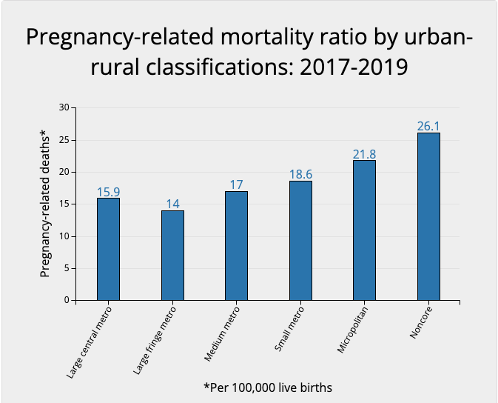
Environmental
Rural vs Urban
Influential Factors
Distance to healthcare
Resources
Obesity Rates
Smoking & Substance Use
Maternal Age
Socioeconomic Status
Complications
Maternal Morbidity
Delivery
Severe Neonatal Morbidity
Pregnancy-Related Mortality
(CDC, 2023; Lisonkova et al., 2016)
Notes:
Faith
First looking at environment
Those who live in urban locations have a great advantage over those who live in rural areas when it comes to perinatal care. Rural areas present with the challenges of greater distance from healthcare, less resources and specialists, higher rates of obesity, higher rates of substance abuse, higher rates of teen pregnancies, and lower socioeconomic status.
In a study conducted in British Columbia, many findings were found highlighting the difference in rural vs urban areas, including maternal morbidity, delivery, and neonatal morbidity.
Rural areas have a greater prevalence of maternal morbidity including eclampsia, obstetric embolism, and uterine rupture. Family physicians and midwifes were more often the ones who delivered the babies, with greater rates of preterm or post-term births and neonates that were large for gestational age. A greater prevalence of severe neonatal morbidity is also seen in rural areas, with more having APgar scores under 7 at five minutes.
Where urban areas see greater prevalence is antepartum hemorrhage at 20 weeks or later, obstetric trauma, and neonates that were small for gestational age
Looking at pregnancy-related mortality, 26.1% were of those in noncore counties with populations under 10,000, compared to 14% in large fringe metro areas of populations over 1 million, with a trend of increased mortality rates with smaller county size, as outlined in the graph.

Slide 5
Economic Factors
Less Prenatal Education
Increased Cesarean Delivery
Higher Mortality Rates
Higher Stress
Less Healthcare Access
Comorbidities
(Milcent & Zbiri, 2018; Mohamoud et al., 2019)
Notes:
Amber
Next, we look at how economic factors impact perinatal care.
Those of low socioeconomic status and lower levels of education have a greater likelihood of not receiving prenatal education. Along with this, those who had greater levels of education saw almost a two times greater likelihood of receiving prenatal education.
Those who do not receive prenatal education have a 2x greater risk of a cesarean delivery, going from 20% to 40%
Neonate mortality in high poverty areas, 38% greater and 47% greater than areas of greater socioeconomic status.
Higher stress can have an impact on maternal and neonatal morbidity, negatively impacting the health of each.
Those with lower socioeconomic status have less access to healthcare due to the challenges of transportation, time, knowledge of importance, and providers who accept Medicaid.
Lastly, those of lower socioeconomic status have greater rates of comorbidities such as obesity or substance use disorder

Slide 6
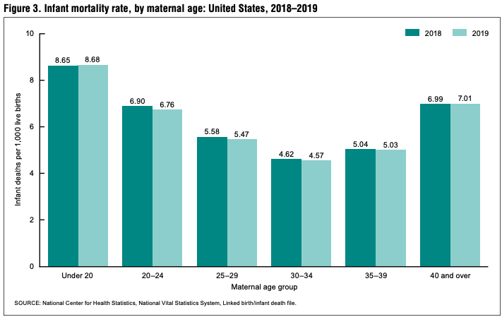
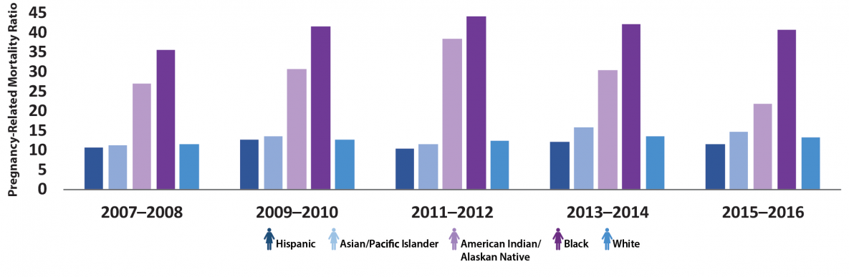
Social Factors
Race
Late Prenatal Care
Cesarean Delivery
Insurance
Pre-term Delivery
Pregnancy-Related Deaths
Infant Mortality
Age
Late Prenatal Care
Cesarean Delivery
Infant Mortality
(CDC, 2022; CDC, 2023; Ely & Driscoll, 2021; Osterman et al., 2023)
Notes:
Cassidy
Now, we will focus on the social factors and how they influence perinatal care and outcomes
First looking at age,
Those under 20 have the lowest rate of early prenatal care at 61.6% compared to those in their 25-34 with the highest around 82%
Those 40 and over were twice as likely to have a c-section compared to those under age 20.
When looking at infant mortality, those under age 20 had the highest rate at 8.68 in 2019, followed by a rate of 7.01 for those 40 and older. The lowest rate was 4.57 for those ages 30-34
Race is another social factor that shows significant impact in perinatal care and outcomes.
The greatest prevalence for third trimester or no prenatal care was found amongst non-Hispanic Black females with a rate of 9.1%, followed by Hispanic females having a rate of 8.4%, and non-Hispanic whites having a rate of 4.6%
Non-Hispanic Blacks had the highest amount of cesarean deliveries, followed by Hispanic women
Of the cesarean deliveries, non-Hispanic black women had the highest rate at 36.8% compared to non-Hispanic white women at the lowest at 31%.
First looking at private insurance, rates were 65% for non-Hispanic white women, 30.8% for non-Hispanic Black women, and 32.1% for Hispanic women
Of those with Medicaid, non-Hispanic white women being 28.1%, non-Hispanic Black women being 58.1%, and Hispanic women at 64%
For Preterm delivery, non-Hispanic white women at 9.5%, non-Hispanic Black women at 14.75%, and Hispanic women at 10.23%
The most common causes of pregnancy-related deaths are complications with cardiovascular conditions, infection or sepsis, cardiomyopathy, hemorrhage, and embolism. Between 2017 and 2019, Non-Hispanic Native Hawaiian or other pacific islanders had the highest rate of pregnancy-related death at 62.8%, followed by Non-Hispanic Black at 39.9%, Non-Hispanic American Indian or Alaska Native at 32%, and 14.1% Non-Hispanic Whites.
In the graphic to the right, it shows the trend in pregnancy-related deaths based on race and ethnicity over 9 years in the U.S., with Non-Hispanic Black females and American Indian/Alaska Natives having consistently high rates during this time.

Slide 7
Resource-Limited Considerations
High risk population
Negative Health Outcomes
(Crandall, 2021)
Notes:
Cassidy
As I mentioned on the previous slide, non-Hispanic black women have the highest rates of third trimester or no prenatal care. It has been found that non-Hispanic black women are 3-4 times more likely to have a pregnancy-related death than white and non-black Hispanics. Individuals who lack prenatal care in the first trimester have a five-fold increase in pregnancy related mortality rates. This data includes individuals who are non-Hispanic Black women as well as those living in rural areas. Unfortunately, the rate of pregnancy-related deaths are steadily increasing in the US, and this outcome is disproportionately more in Non-Hispanic Black women as I mentioned above. These disparities persist despite controlling variables such as socioeconomic status, education levels, and geographical location.
There are several barriers to care that have been found among the non-Hispanic Black women community. These include personal barriers such as substance abuse, psychological stressors, lack of family support, and housing problems. Structural barriers that have been found include lack of transportation, limited childcare for other children during appointments, or inability to locate or financially afford care.
Rural communities have several barriers when it comes to maternal health. These include food insecurity, housing instability, transportation challenges, and lack of educational and employment opportunities. These challenges are increased in racial and ethnic minority women living in rural areas. Accessing maternal healthcare in rural communities is becoming more and more difficult due to the closure of rural hospitals and obstetric units. This could be due to staffing issues, low reimbursement, low birth volume, or financial challenges. In the United states there is a shortage of maternal healthcare providers which only adds to the issue of rural women being unable to access perinatal care.
The barriers I have mentioned above increase the risk of having several complications, but a few include having a child with a low birth weight, preterm labor, and complications following the birth that include hemorrhage, embolism, and ultimately death.

Slide 8
Opportunities for Improvement
Accessible
Affordable
Risk-appropriate
High Quality
Patient Centered
Innovative
Coordinated
Equitable
(CMS, 2019)
Notes:
Cassidy
When it comes to accessibility, rural health areas utilize midwives in 30% of deliveries in rural hospitals. Studies have shown that using midwives has improved infant and maternal outcomes. Other opportunities for improvement include expanding the training of maternal health providers in rural areas, have an incentive for providers to practice in rural areas, recruit and retain providers in rural communities, and standardize the scope of practice laws for maternal health providers.
For individuals who are uninsured, there have been several improvements to overcome this barrier. The Strong Start for Mothers and Newborns Initiative is one of these. Other improvements include expanding and extending insurance coverage, unbundling postpartum services, and establishing accountable care organizations covering maternal health services.
One barrier that rural areas and non-Hispanic Black women face is access to risk-appropriate, quality care. Opportunities for improvement include defining and adopting a risk-appropriate care model like the Levels of Care Assessment Tool. This tool allows providers to support decision making about risk-appropriate care for women in their region.
Ensuring high quality care is another opportunity for improvement. To improve the quality of maternal health care, it is important to establish Perinatal Quality Collaboratives or PQCs. PQCs aim to improve quality of care across the perinatal period but are particularly focused on reducing racial and geographic disparities.
Having the care be patient centered includes being respectful and responsive to individual patient preferences, needs, and values. Examples of patient-centered care includes maternity medical homes, culturally tailored initiatives, and responsive leadership and workforce.
One of the biggest innovations in healthcare includes telehealth. Telehealth is highly underutilized in rural communities due to several barriers, however, it is a tool that can be used to deliver maternal health services to rural areas.
Coordinated care includes access to behavioral and social services. Racial and ethnic minorities are less likely to receive treatment for any mental illness. Rural communities tend to have limited access to social services. Opportunities to improve access include behavioral health screening, partnerships with community services such as WIC, and utilizing or implementing community health workers, home visitors, case managers, and social workers to screen and link patients to essential services.
And finally, we have equitable care. While there has been improvements in quality of care in recent years, these efforts have not reduced health disparities for non-Hispanic Black women. AIM maternal safety bundle on reduction of peripartum racial/ethnic disparities is one resource that helps health systems improve their data collection, staff training, and engagement to address racial and ethnic disparities among their populations.

Slide 9
Case Study
Race: non-Hispanic Black
Substance use: denies illicit drugs or smoking/vaping, occasional alcohol use socially (3-4 drinks once a month)
Social: works full time shift work at local convenience store, single parent to 2 year old daughter, lives with mother, sister and daughter, shares a vehicle with her sister, lives in rural area with nearest hospital/large city 2 hours away
Cultural: denies implications
Religion: Christian, non-denominational
Socioeconomic: minimum wage, no child support for daughter
Insurance: Medicaid
24 year old female
CC: suspected pregnancy
PMH: none
Allergies: NKDA
Medications: none
ROS: LMP 3 months ago, positive for nausea, fatigue and weight gain
PE: semi-firm abdomen at pubic bone
Notes:
Amber
To illustrate the effects of health disparities in prenatal care we will look at the case of a 24 year old female who presents to our care with suspected pregnancy. She has no PMH, no allergies and takes no medications. Her LMP was about 3 months ago, she complains of nausea, fatigue and 10 lb weight gain. Her physical exam is grossly unremarkable aside from semi-firmness to lower abdomen just above her pubic bone suggestive of fundal height consistent with approx 12 week pregnancy
She is non-Hispanic Black. She denies drug use or smoking and uses alcohol occasionally. She works shift work at local convenience store. She lives with her mother, sister and 2 year old daughter to whom she is a single parent. She shares a car with her sister. They live in a rural community 2 hours from the nearest hospital that supports childbirth. She denies any religious or cultural implications to healthcare. She earns minimum wage, does not receive child support and is insured by Medicaid.
Thinking back to the risk factors discussed by Faith and Cassidy we can see that this patient has several risk factors for poor obstetric outcomes including her race, low socioeconomic status and Medicaid. She also has barriers to obtaining prenatal care including being a single parent, her demanding job, shared vehicle and distance to healthcare.

Slide 10
Case Management
Immediate
Fetal heart tones
OB referral
Intermediate
Local appointment
Transportation
Long-term
Confirm pregnancy
Prenatal education
WIC
TANF
SNAP
Telehealth
Right Tracks
Local lab and US
Notes:
Amber
Immediate:
-Confirm pregnancy with hcg
-Perform fetal heart tones (no US available today)
-Educate start prenatal vitamins
-do's and don’t's of food and medications
-referral to OB
Intermediate: coordination and continuity of care
-Local appointments when able: local clinic and neighboring towns have visiting OB providers routinely which would be less of a burden travel and time wise. We can help her organize appointments as close to home as possible for as long as possible.
-Local lab and ultrasound as much as possible
--Telehealth visits when appropriate
-Transportation assistance: public transportation in town, local organizations (church, senior center) to assist with out of town appointments, correlate out of town appointments with public bus schedule
-As her pregnancy progresses she may have to travel to the city with the hospital where she can deliver for appointments.
Long-term: help with resources to apply for, involve social services/social work for assistance
-WIC program referral: provides food, healthcare referrals, nutrition services for pregnant, postpartum and children up to 5 years
-SNAP: food stamps
-TANF: temporary assistance for needy families= short term help to pay for food, utilities, medical supplies
--Right Tracks Early Intervention Program: free, in-home developmental screenings for children birth to 3 years old (does not replace well-child visits but is a good supplement)

Slide 11
Conclusion
Social disparities are a significant factor in outcomes
Perinatal Care
  Race, socioeconomic status, age, environment
We can help!
Notes:
-Social disparities have the potential to significantly impact the health outcomes of our patients
-In terms of prenatal care race, socioeconomic status, age and environment are of key importance
-We can use our role as healthcare providers to help with identifying resources, making referrals and being creative with our patients to find solutions that work for them.

Slide 12
References
Centers for Disease Control and Prevention [CDC] (2022, April). Infographic: racial/ethnic disparities in pregnancy-related deaths – United States, 2007-2016. Division of Reproductive Health, National Center for Chronic Disease Prevention and Health Promotion. https://www.cdc.gov/reproductivehealth/maternal-mortality/disparities-pregnancy-related-deaths/infographic.html
Centers for Disease Control and Prevention [CDC]. (2023, March). Pregnancy mortality surveillance system. Centers for Disease Control and Prevention. https://www.cdc.gov/reproductivehealth/maternal-mortality/pregnancy-mortality-surveillance-system.htm#:~:text=Since%20the%20Pregnancy%20Mortality%20Surveillance,100%2C000%20live%20births%20in%202018
Center for Medicare & Medicaid Services. (2019). Improving access to maternal health care in rural communities: An issue brief [PDF]. https://www.cms.gov/About-CMS/Agency-Information/OMH/equity-initiatives/rural-health/09032019-Maternal-Health-Care-in-Rural-Communities.pdf
Crandall, K. (2021). Pregnancy-related death disparities in non-hispanic black women. Women's Health, 17, 174550652110198. https://doi.org/10.1177/17455065211019888
Ely, D. M. & Driscoll, A. K. (2021, December 8). Infant mortality in the United States, 2019: data from the period linked birth/infant death file. U.S. Department of Health and Human Services National Vital Statistic Report, 70(14). https://www.cdc.gov/nchs/data/nvsr/nvsr70/nvsr70-14.pdf
Lisonkova, S., Haslam, M. D., Dahlgren, L., Chen, I., Synnes, A. R., & Lim, K. I. (2016, December 06). Maternal morbidity and perinatal outcomes among women in rural versus urban areas. Canadian Medical Association Journal, 188(17-18), E456-E465.https://doi.org/10.1503/cmaj.151382
Milcent, C. & Zbiri, S. (2018). Prenatal care and socioeconomic status: effect on cesarean delivery. Health Economics Review, 8(1), 7. https://doi.org/10.1186/s13561-018-0190-x
Mohamoud, Y. A., Kirby, R. S., & Ehrenthal, D. B. (2019). Poverty, urban-rural classification and term infant mortality: a population-based multilevel analysis. BMC Pregnancy and Childbirth, 19(1), 40. https://doi.org/10.1186/s12884-019-2190-1
Osterman, M. J. K., Hamilton, B. E., Martin, J. A., Driscoll, A. K., & Valenzuela, C. P. (2023, January 31). Births: final data for 2021. U.S. Department of Health and Human Services National Vital Statistic Report, 71(1). https://www.cdc.gov/nchs/data/nvsr/nvsr72/nvsr72-01.pdf

