Slide 1
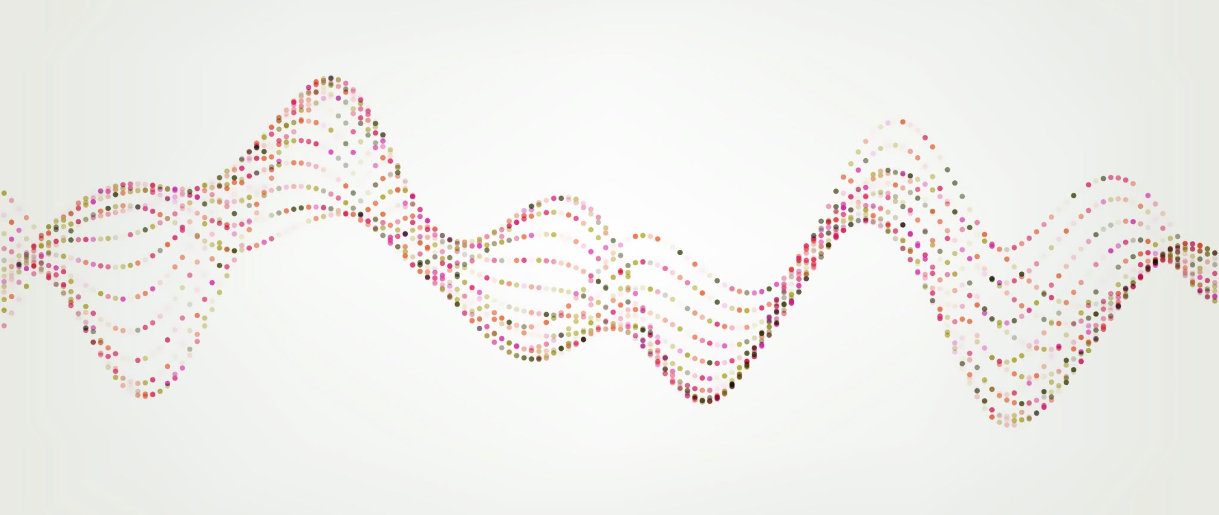


Enuresis/Dysfunctional Voiding
Cassidy Freeman, DNP-S
University of Mary

Slide 2
Introduction
Enuresis
    Intermittent urinary incontinence during sleep in a child at least 5 years
    5-10% of all 7 year olds
    5-7 million children in the U.S.
Dysfunctional Voiding
    Voiding disorder characterized by dyssynergic striated sphincteric activity
    40% of pediatric urology clinic visits
(Baird, Seehusen, & Bode, 2014; Sinha, 2011)

Slide 3
Objectives
Explain the pathophysiology of enuresis and dysfunctional voiding
Describe the common presentation
List potential differential diagnoses
Identify red flags
Identify important pieces to the H&P
Explain the process of diagnosing
List how to treat/manage

Slide 4
Pathophysiology
Enuresis
Inability to awaken from sleep in response to voiding stimulus
Excessive nighttime urine production or decreased functional capacity of the bladder
Dysfunctional voiding
Inability to relax the urethral sphincter and/or pelvic floor musculature during voiding
Abnormality in either filling or emptying of the bladder
(Baird et al., 2014; Sinha, 2011)
Notes:
The pathophysiology of Enuresis involves the inability to awaken from sleep in response to a voiding stimulus coupled with excessive nighttime urine production or decreased functional capacity of the bladder. There are different sub-classifications of enuresis – primary vs secondary and monosymptomatic or non-monosymptomatic types. Primary enuresis refers to those who have never achieved 6 continuous months of dry nights. Secondary enuresis occurs when children who have had 6 continuous months of dry nights relapse. This type is more likely to happen if there is a new psychosocial stressor or an underlying medical or behavioral condition. Monosymptomatic enuresis only includes nighttime bedwetting. Non-monosymptomatic enuresis includes daytime lower urinary tract symptoms like urgency, dribbling, or incomplete emptying, or daytime incontinence, dysuria, or holding maneuvers (standing on the tiptoes, crossing the legs, pressing the heel or hand into the perineum. Non monosymptomatic enuresis is suggestive of overactive bladder, dysfunctional voiding, or other serious pathologies.
- This leads us to the pathophysiology of dysfunctional voiding. Dysfunctional voiding is the inability to relax the urethral sphincter and/or pelvic floor musculature. This disorder has been considered a habitual disorder possibly due to the child learning the wrong habit of contracting the striated urethral sphincter-pelvic floor complex rather than relaxing it during voiding. This occurs due to inappropriate toilet training or as a response to urgency or pelvic discomfort. May result from persistent infantile or fetal voiding patterns, familial or hereditary origins, get triggered inadvertently by parents or teachers, and may be associated with behavioral problems. If a cause is not determined, the search for an unidentified neurological lesion should be done.

Slide 5
Common Presentation
Enuresis
  Discrete episodes of urinary incontinence during sleep in children greater or equal to 5 years of age.
  Anxious or tense child
  Normal physical exam
  Normal UA
  Normal PVR
Dysfunctional voiding
  Urinary incontinence during day and night
  May have frequency, urgency, urge incontinence, nocturnal enuresis
(Tu et al., 2022; Sinah, 2011)
Notes:
The presentation for enuresis is quite simple. The child is having episodes of urinary incontinence during sleep and they are 5 years of age or older. The child may be anxious or tense. The child will typically have a normal physical exam, normal UA, and normal Post void residual.
Dysfunctional voiding typically presents with urinary incontinence during the day and night. Common associated symptoms include frequency, urgency, urge incontinence, and nocturnal enuresis.

Slide 6
Potential Differentials
Enuresis
UTI
Constipation
Seizure
Diabetes mellitus
Diabetes insipidus
Sleep apnea
Neurogenic bladder
Genitourinary malformation
Hyperthyroidism
Dysfunctional voiding
UTI
Secondary bladder overactivity due to constipation
Polyuria
(Wilson & Gupta, 2023; Sinha, 2011)

Slide 7

Red Flags
Rule out seizure as enuresis can occur in the ictal phase
Growth delay or failure to thrive may mean CKD or DM
Adenotonsillar hypertrophy
Spinal pathology – deformity, sacral dimple or hair tuft
Motor sensory loss and abnormal tendon reflexes in lower limbs
Enlarged bladder or kidneys
Abnormal gait
Signs of sexual abuse
S/S of UTI
Hydronephrosis
VUR
Renal Dysfunction
Marked Voiding Difficulty
(Ramakrishnan, 2008; Nepple & Cooper, 2023 )

Slide 8

Important H&P Points
Enuresis
Frequency, Timing, Volume
Daytime lower urinary tract symptoms
Sense of child and parents’ concerns & motivation/desire for treatment
Bladder diary
Dysfunctional voiding
Directed towards type of urinary symptom, severity, and health/integrity of urinary tract
Bowel function should be evaluated in detail
(Sinha, 2011; Baird et al., 2014)

Slide 9
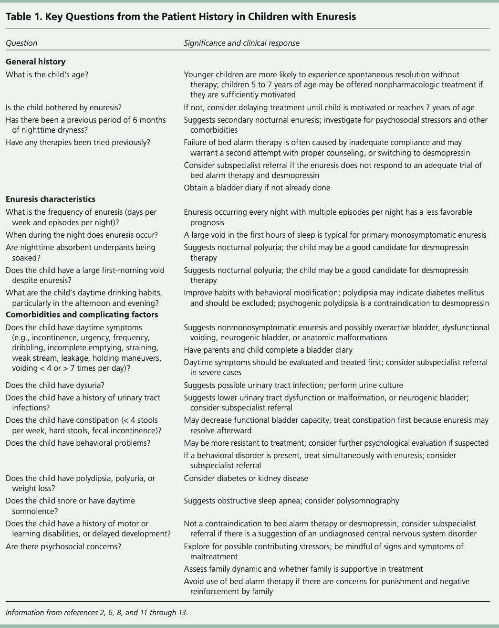
Enuresis H&P
(Baird et al., 2014)

Slide 10
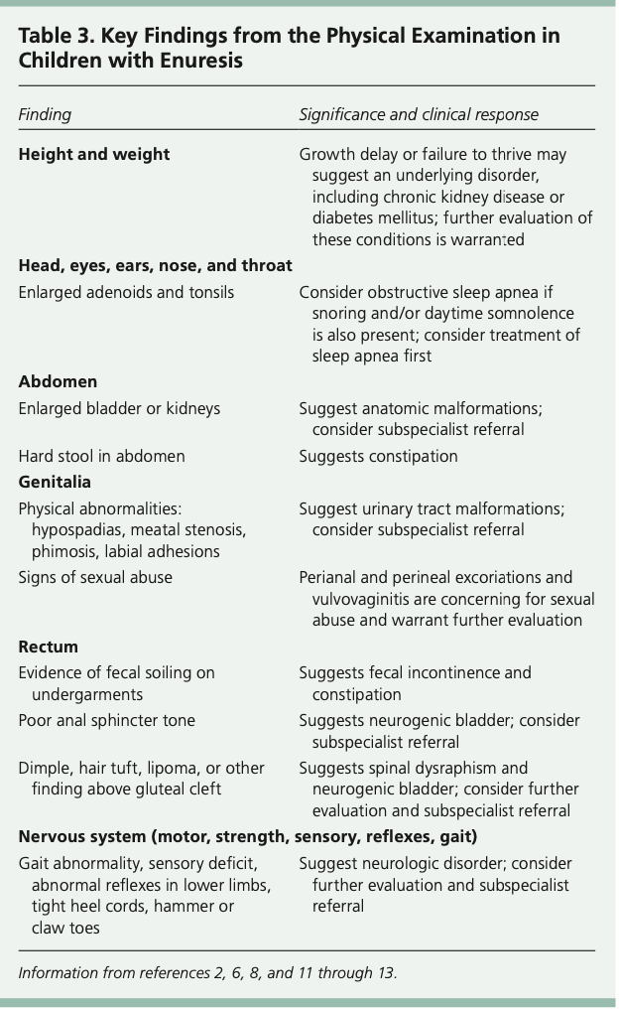
Enuresis Key Physical Exam Findings
(Baird et al., 2014)

Slide 11
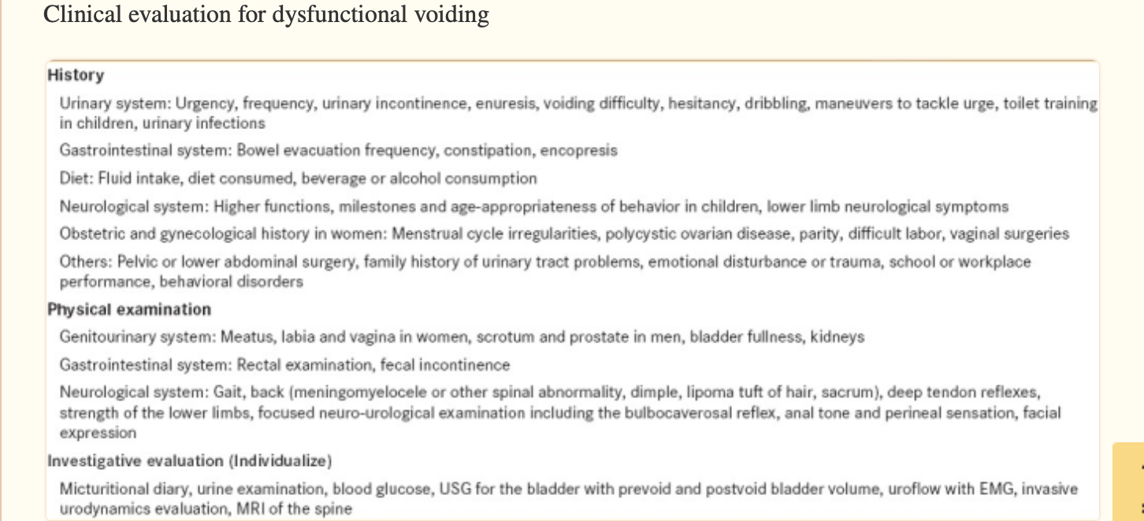
Dysfunctional Voiding H&P
(Sinha, 2011)

Slide 12
Diagnostics
Enuresis
Dysfunctional voiding
UA
Renal ultrasound
Bladder ultrasound
MRI
Voiding cystourethrography and urodynamic studies
Based on one or more: increased frequency, urgency, hesitancy, dribbling, holding maneuvers to suppress voiding, abnormality of urinary flow, abdominal straining during voiding
Uroflow testing
Urodynamics
Ultrasound
Cystoscopy
(Baird et al., 2014; Sinha, 2011; Nepple & Cooper, 2023)
Notes:
The first step when diagnosing a child with enuresis is to rule out potential causes for the enuresis. The first test that should be done is a UA. If glycosuria or proteinuria is present, further testing should be done and can include serum glucose, BUN, and serum creatinine levels. If bacteria or WBCs are present in the UA a urine culture should be done. If signs and symptoms suggest nonmonosymptomatic enuresis or an underlying medical condition, a renal ultrasound can be done to detect kidney disease or anatomic malformations. A bladder ultrasound can be used to detect lower urinary tract malformations, bladder capacity, bladder wall thickness, and post void residual urine volume. MRI can be done is there is a concern for occult spinal dysraphism or other CNS disorders. Last the voiding cystourethrography and urodynamic studies are more invasive diagnostic procedures and should only be done for more complicated cases.
Diagnosing dysfunctional voiding can be done simply based off the H&P and must have one or more of the following. Increased frequency, urgency, hesitancy, dribbling, holding maneuvers to suppress voiding, abnormality of urinary flow, abdominal straining during voiding. Uroflow testing can be done and should show a repeated demonstration of a staccato pattern when dysfunctional voiding is present. A normal uroflow pattern should be a bell curve. On the next slide I have included an example of this staccato pattern. The definitive test for obstruction is urodynamics. This test can be challenging to complete in children due to cooperation of the child and the narrow size of the urethra. Ultrasound is useful to examine the bladder and measure residual urine in patients with lower urinary tract symptoms. In older children, a consistent residual of >20ml is considered abnormal. A cystoscopy can be done for those with longstanding or severe obstruction. Routine diagnostic cystoscopy is not recommended.

Slide 13
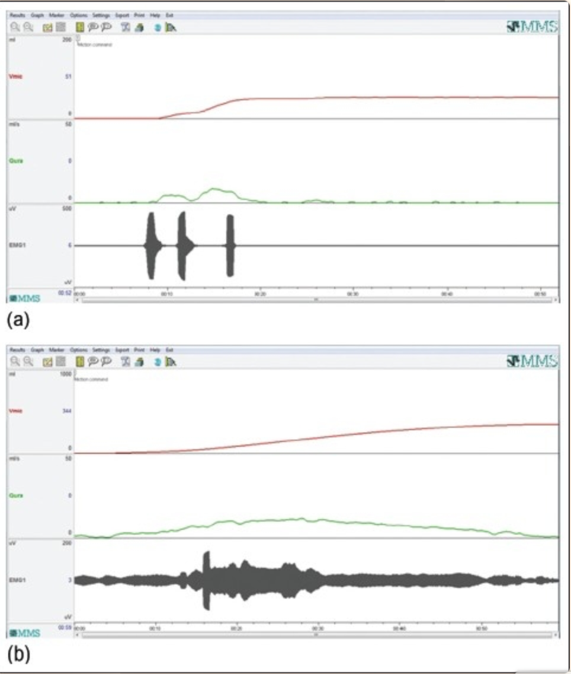
Staccato Uroflow Test
(Sinha, 2011)

Slide 14
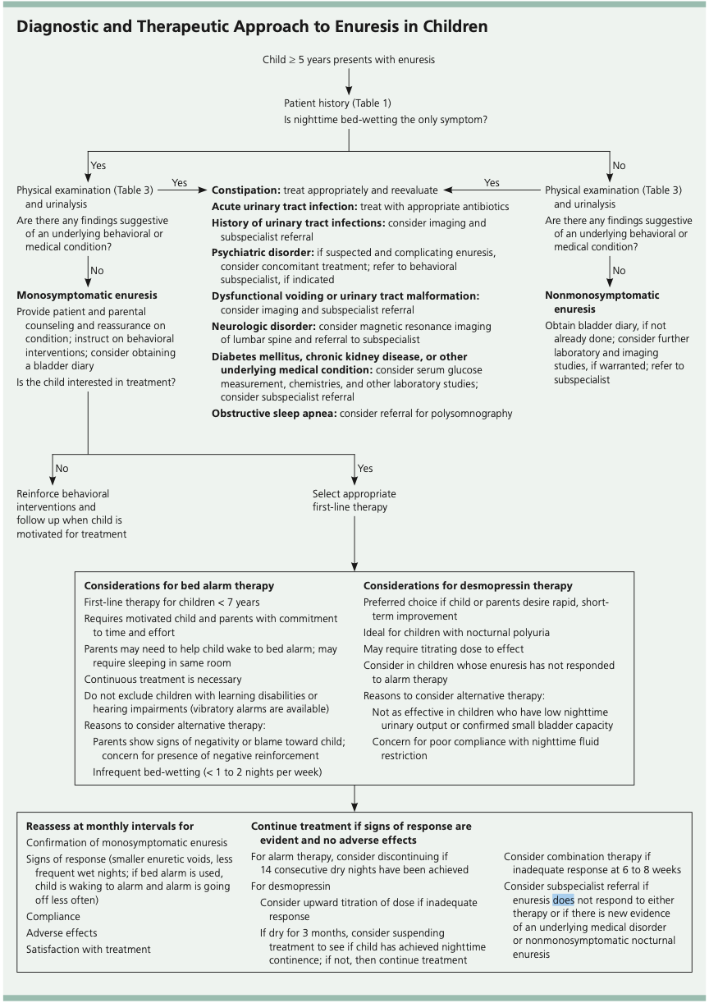
Enuresis Diagnosis
(Baird et al., 2014)
Notes:
This algorithm is a wonderful tool to use when diagnosing someone with enuresis. I also appreciate that it includes the treatment options which we will discuss on the next slide.

Slide 15
Management/Treatment Goals
Enuresis
Dysfunctional Voiding
Behavioral interventions
Bed alarm therapy
Desmopressin
Bladder diary
Goal:
  Enable patients to learn to relax the bladder outlet
Hypnosis
bladder retraining
bladder drill
biofeedback for the pelvic floor
Anticholinergic medications
Alpha adrenergic blockers
Intermittent self-cath
Urotherapy
(Sinha, 2011; Baird et al., 2014)
Notes:
The management for enuresis is fully dependent on the motivation of the parents and the child. Parents should be reassured that it is common and resolves spontaneously in most children. If the parent or child is not motivated to use the treatment options we will discuss, behavioral interventions can be used as a starting point. This includes, limiting fluid intake before bed, waking the child at night when they typically would have an incontinent episode, bladder training – delay urination during the day to increase bladder capacity, pelvic floor and sphincter control exercises, and reward systems. The key to behavioral interventions is to avoid negative consequences. Bed alarm therapy is currently the most effective therapy and is considered first line treatment for enuresis. These bed alarms have a moisture sensor that is placed on the child’s undergarments or as a pad underneath the child. This sensor is connected to an alarm system that signals when wetness is detected. The goal is for the child to wake up at the beginning of the episode, stop urinating temporarily, shut off the alarm, and go finish urinating in the toilet. This alarm system should be used for a minimum of 3 months and should be continued until 14 consecutive dry nights are achieved. The use of desmopressin should be limited to children that are 7 and older. It should be noted that once this medication is discontinued, symptoms are likely to return. Desmopressin should be withheld periodically every 3 months to assess if nighttime continence has been achieved. Finally, a bladder diary can be used to assess voiding patterns, urine output, and daytime drinking habits. This can help guide the provider in selecting treatment, suggest behavioral modifications, and assess response to any treatment.
The goal for treatment with dysfunctional voiding is to enable patients to learn how to relax the bladder outlet during voiding. There are several approaches that have been tried including hypnosis, bladder retraining, bladder drill, biofeedback for the pelvic floor, anticholinergic medications to relax the bladder and alpha adrenergic blockers to relax the bladder neck. Intermittent self catheterization can be done for those with high-risk markers. Initial management for patients without high risk factors includes conservative urotherapy including biofeedback. This method can reduce constipation, urinary infections, and interventions for vesicoureteral reflux. The first step is an initial evaluation and education. The second step is a series of biofeedback sessions including having the child watch a uroflow curve and teaching how to identify and contract/relax the pelvic floor muscles. The third step consists of bowel care, preparation of a voiding diary, and pelvic floor exercises. The fourth step includes identification of persistent behavioral and psychological issues.

Slide 16
Patient Education
Enuresis is common, not volitional, and resolves with time
Stress and lowered self-esteem due to punishment or shame
Avoid blaming
Limit intake of fluids during the evening
Encourage use of bathroom during the day and before bedtime
Remind child not to hold in urine and urinate before they feel the urge
Treat constipation
(Wilson & Gupta, 2023; Nepple & Cooper, 2023)

Slide 17
Follow up
Bed alarm therapy- 4 weeks
Desmopressin – 2-4 weeks
Urotherapy – 4-8 weeks
Anticholinergics – 4 weeks
(Baird et al., 2014; Nepple & Cooper, 2023)

Slide 18
Referral Criteria
Enuresis
Dysfunctional Voiding
Urology or nephrology
  Failure to respond to bell and pad method or desmopressin
Neurology
  Suspected underlying neurological or seizure disorder
Endocrinology
  Suspected diabetes mellitus, hormone abnormality, or hyperthyroidism
Otolaryngology
  Recommended if OSA is suspected
Psychiatry
  Useful if other comorbid psychiatric conditions or if motivational therapy is needed
Urology
  Further diagnostic evaluation
  Failure to improve after initial trial of conservative management
  Suspicion of neurologic or anatomic etiology
  Constant continuous incontinence
  Suspected kidney damage
(Nepple &Cooper, 2023; Wilson & Gupta, 2023)

Slide 19

Current Studies in Progress
At home use of parasacral transcutaneous electrical nerve stimulation (PTENS)
  Feasible with reasonable treatment adherence and minimal adverse events
Notes:
This study looked at using PTENS rather than behavioral changes that require a lot of time or medications that are often avoided or discontinued because of side effects. Prior studies have tested the efficacy of PTENS however, the safety and feasibility have not been looked at. The adverse events that were reported include pruritus around the pad site, and discomfort when removing the pads. Prior studies utilized the PTENS units in a controlled environment which affected adherence. This study found that treatment adherence was increased with it being at home. It should be noted that this was a fairly small trial with only 30 participants. Another limitation is that the particpants were already adherent to a specialty clinic for voiding dysfunction. In order for this to be used, more studies need to be conducted without these limitations in place.

Slide 20
Conclusion
Enuresis
Dysfunctional Voiding
inability to awaken from sleep in response to a voiding stimulus coupled with excessive nighttime urine production or decreased functional capacity of the bladder
incontinence during sleep
Common and will go away
abnormality in either filling or emptying of the bladder
Incontinence during day or night
Urotherapy and biofeedback therapy

Slide 21
References
Baird, D., Seehusen, D., & Bode, D. (2014). Enuresis in children: a case-based approach. American Academy of Family Physicians, 90(8), 560–568. https://www.aafp.org/pubs/afp/issues/2014/1015/p560.pdf
Nepple, K. G., & Cooper, C. S. (2023). Evaluation and diagnosis of bladder dysfunction in children (L. S. Baskin, T. K. Mattoo, & A. G. Hoppin, Eds.). UpToDate. Retrieved March 16, 2024, from https://www.uptodate.com/contents/evaluation-and-diagnosis-of-bladder-dysfunction-in-children?search=dysfunctional%20voiding%26source=search_result&selectedTitle=3%7E150&usage_type=default&display_rank=3#H10
Ramakrishnan, K. (2008). Evaluation and treatment of enuresis. American Academy of Family Physician, 78(4), 489–496. https://www.aafp.org/pubs/afp/issues/2008/0815/p489.html
Sinha, S. (2011). Dysfunctional voiding: A review of the terminology, presentation, evaluation and management in children and adults. Indian Journal of Urology, 27(4), 437. https://doi.org/10.4103/0970-1591.91429
Tu, N. D., Baskin, L. S., & Arnhym, A. M. (2022). Nocturnal enuresis in children: Etiology and evaluation (J. E. Drutz, R. G. Voigt, & N. Tehrani, Eds.). UpToDate. Retrieved March 16, 2024, from https://www.uptodate.com/contents/nocturnal-enuresis-in-children-etiology-and-evaluation?search=enuresis%20in%20children%26source=search_result&selectedTitle=2%7E105&usage_type=default&display_rank=2#H540528631
Wilson, M., & Gupta, V. (2023). Enuresis. StatPearls. https://www.ncbi.nlm.nih.gov/books/NBK560565/#

