Slide 1

Meningitis
Cassidy Freeman
NUR 837 Acute & Emergent Problems
Dr Jenna Herman & Dr Billie Madler
July 8th, 2024

Slide 2
Objectives
Identify what meningitis is
1
Discover the initial steps when a person presents with meningitis
2
List the differentials
3
List the pertinent positives and negatives for meningitis
4
Identify the correct diagnostics for meningitis
5
Discover how to manage a patient presenting with meningitis
6
Explain the proper follow up and disposition for individuals with meningitis
7

Slide 3

Introduction
Meningitis is the inflammation of the lining of the brain and spinal cord
Many different causes of meningitis
Bacterial meningitis is a medical emergency
  1 in 6 people die
  1 in 5 have severe complications
Viral meningitis
  Life-changing after effects
(Hersi et al., 2023)
Notes:
So to start I wanted to define meningitis. Meningitis is the inflammation of the lining of the brain and spinal cord. It is characterized by an abnormal number of white blood cells in the CSF in the majority of patients. There are many different causes of meningitis with bacterial and viral being the most common but can also include fungal and parasites. It is very important to recognize that bacterial meningitis is a medical emergency and needs to be identified and treated as quickly as possible. In fact, around 1 in 6 people who get bacterial meningitis die while 1 in 5 have severe complications. Viral meningitis is the most common and for some can cause life-changing after effects which we will discuss later in the presentation

Slide 4
Initial Approach
Notes:
Now we will dive into the initial approach for patients presenting with meningitis.

Slide 5
Red Flags and Differentials
Important Red Flags
Differentials
Fever, stiff neck, headache, AMS
Sudden onset
Signs of increased ICP – AMS, neurologic deficits, and seizures
Neonates and infants – s/s less evident
Stroke
Subarachnoid Hemorrhage
Subdural Hematoma
Metastatic brain disease
Brain abscess (may coexist)
(Hasbun 2024a; Hersi et al., 2023)
Notes:
The presentation of fever, headache, stiff neck, and Altered mental status is commonly seen in patients with bacterial meningitis and should not be overlooked. Most patients have at least 2 of the four symptoms but their absence does not exclude meningitis. Headache is the most common symptom with fever being the second most common. These symptoms typically have a sudden onset. Another red flag to be aware of includes signs of increased ICP as this can lead to brain herniation. These include a GCS less than 11, lethargy, AMS, new onset seizures, and focal neurologic deficit.
When differentiating meningitis from other diagnoses, it is important to recognize that meningitis can occur in conjunction with the listed differentials. It is also important to realize that a lot of the symptoms that occur with meningitis can also occur with the listed differentials. To either rule in or rule out meningitis, CSF analysis should be done. To definitively rule out the listed differentials, a head CT or MRI should be done.

Slide 6
History and Physical
History
Close quarters
Unvaccinated
Older adults
Alcohol abuse
Previous head trauma/surgery
Immunocompromised
Time of initial symptoms
Physical
Fever
Headache
Stiff neck
Altered mental status
Less common – seizures, aphasia, hemi-/monoparesis, coma, cranial nerve palsy, rash, papilledema
(Hasbun, 2024a; Tansk & Ma, 2020)
Notes:
When gathering the history from the patient or family it is important to consider certain risk factors for meningitis. This includes living in close quarters like military barracks or dorm rooms, being unvaccinated, older adults, alcohol abuse, penetrating head trauma, or recent brain surgery. Other risk factors include those that are immunocompromised. It is important to ask questions to determine a history of exposures, sexual contact, animal contact, previous neurosurgical intervention, recent travel, and the time of year as viral cases are more common in the warmer months. Another important question to ask is the time of symptom onset. As approximately half of the patients in a retrospective study with bacterial meningitis present less than 24 hours after onset of symptoms.
Now we will discuss the physical findings consistent with meningitis. The presentation of fever, headache, stiff neck, and altered mental status are the most common symptoms seen in patients with bacterial meningitis. Most patients will have at least 2 of the 4 symptoms but their absence does not exclude meningitis. Headache is the most common symptom and is seen in more than 85% of patients. Fever is the second most common. Seizures and focal neurologic deficits are seen in 25-30% of patients. Evaluating for focal neurologic dysfunction includes checking for hemiparesis, visual field deficits, or disordered eye movements. Increased intracranial pressure can cause papilledema or cranial nerve palsy, especially with cranial nerves 3, 4, 6, and 7. To assess for meningeal irritation, the Brudzinski sign can be done. This is the flexion of the hips and knees in response to passive neck flexion. The kernig sign should also be done to assess for meningeal irritation. This is the contraction of the hamstrings in response to knee extension while the hip is flexed. Specific skin rashes that should be assessed include petechiae, splinter hemorrhages, and pustules.

Slide 7
Emergent Interventions
Blood cultures
Avoidance of delay in antimicrobial therapy
Lumbar puncture vs CT
Dexamethasone
(Hasbun, 2024a; Hasbun, 2024b; Tansk & Ma, 2020)
Notes:
The initial approach to a patient with suspected bacterial meningitis includes a lumbar puncture to determine whether CSF findings are consistent with the diagnosis. I do want to mention that a head CT should be performed prior to a lumbar puncture if one or more of the following risk factors exist. Immunocompromised state, hx of CNS disease (like a mass, stroke, or focal infection, new onset seizure within a week of presentation, papilledema, abnormal LOC, focal neurologic deficit. However, on the next slide I will go through an algorithm that shows the first initial step should be to obtain blood cultures prior to CT scan or lumbar puncture. This is due to the importance of avoiding delay in antimicrobial therapy as delay increases risk of death by 30%. If a head CT is indicated, blood cultures are to be obtained, dexamethasone and antimicrobial therapy should be started. If the results of the CT reveal that a lumbar puncture is contraindicated, therapy for bacterial meningitis should be continued if indicated or treatment for alternative diagnosis should begin. Even if a CT is not indicated, blood cultures should be done prior to the lumbar puncture. Once the CSF has been collected and prior to results, dexamethasone and antimicrobial therapy should be initiated.
Of course, other things to consider during the emergent phase would be your ABCs. Attending to these should also be a priority in the patient presenting with meningitis. This is especially true if the patient is unresponsive, had a seizure and is now in a post ictal phase, or has neurological deficits that are hindering the persons airway or breathing.

Slide 8
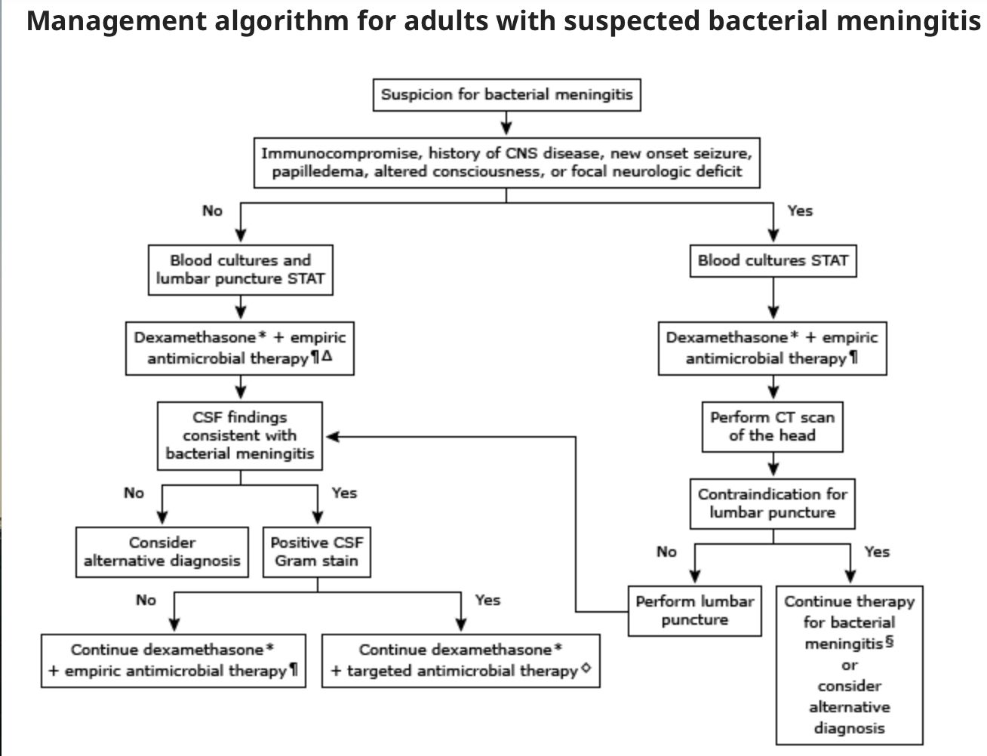
(Hasbun, 2024b)
Notes:
I like this algorithm because it clearly states what I tried explaining in the previous slide. The pathway to the right is when a CT is indicated and the steps for directing that as the left side shows the path for lumbar puncture without CT.

Slide 9
Clinical Reasoning and Medical Decision Making
Notes:
Now we will discuss the clinical reasoning and medical decision making behind the management of meningitis

Slide 10
Diagnostics
Lumbar puncture
PCR
Serum procalcitonin, CRP, and CSF lactate
CT scan
Blood cultures
CBC with differential
Platelets
CMP
(Hasbun, 2024b; Tansk & Ma, 2020)
Notes:
CSF should be sent for cell count and differential, glucose concentration, protein concentration, gram stain, bacterial culture, and PCR. Characteristic findings in bacterial meningitis includes a CSF glucose concentration of less than 40mg/dl, a CSF to serum glucose ration of less than or equal to 0.4, a protein concentration of greater than 200 mg/dL, and White blood cell count above 1,000 usually composed of neutrophils. I do want to mention that antimicrobial therapy is warranted when bacterial meningitis is suspected clinically even if the CSF abnormalities are not diagnostic.
A PCR can be done as it has been evaluated in patients with bacterial meningitis and has shown high sensitivity and specificity. This has been found to be the most useful especially in those with a negative CSF gram stain or culture or those who have received prior antimicrobial therapy.
Serum procalcitonin, CRP, and CSF lactate concentrations can be used as adjuncts to diagnosis of bacterial meningitis with negative CSF examinations but should not substitute decision making for treatment in the individual patient.
I have already discussed the need for CT so moving on to initial blood tests.
Initial blood tests should include a CBC with differential, platelet count, and two aerobic blood cultures. A CMP should also be done to help determine the CSF to blood glucose ratio. This should be drawn within 1 hour of obtaining the lumbar puncture to have a reliable ratio.

Slide 11
Management
Age 18-49
Third generation cephalosporin (cefotaxime 2g IV or ceftriaxone 2g IV) plus vancomycin 15-20 mg/kg IV
Age 50+/ immunocompromised
Add ampicillin 2g IV
Dexamethasone
Fluid management
Reduction of ICP
Treat fever and manage seizures
(Hasbun, 2024b; Tansk & Ma, 2020)
Notes:
Once the blood cultures are drawn, it is important to start antimicrobial therapy as we discussed. Current guidelines recommend for the ages of 18-49 to use a third generation cephalosporin like cefotaxime or ceftriaxone plus vancomycin. For those over the age of 50 or are immunocompromised, it is recommended to add ampicillin to the regimen. The cephalosporin and vancomycin are used to cover the common pathogens of s pneumoniae and n meningitidis. Adding ampicillin will allow for coverage of L monocytogenes.
The addition of dexamethasone is recommended either before or with the first dose of antibiotics as it can reduce CSF inflammation, reduce the risk of morbidity and mortality in adults as well as reduce hearing loss and other neurologic sequelae in children.
Additional management for these patients should include close monitoring for complications or signs of clinical deterioration, especially with respiratory and neurologic status. For these patients, careful management of fluid and electrolyte balance is important as over and under hydration are associated with adverse outcomes. It is recommended to avoid hypotonic fluids and to monitor serum sodium levels serially to detect SIADH or cerebral salt wasting.
It is also important to evaluate for signs of increased ICP which can lead to brain ischemia. If signs of increased ICP are detected, it is recommended to elevate the HOB to 30 degrees, use 25% mannitol or hypertonic 3% saline, and consider mild hyperventilation to maintain PaCO2 between 27 and 30. If patients are found to have increased ICP or are comatose they may benefit from insertion of an ICP monitoring device. The ICP goal should be less than 15-20.
Other supportive measures that should be done in these patients includes the treatment of fevers and managing seizures with anticonvulsants.

Slide 12
Disposition and Follow Up
Intensive care unit
Prognosis
Neurologic complications
(Hasbun, 2024b; Tansk & Ma, 2020)
Notes:
For the disposition of these patients the current recommendations are to admit all patients diagnosed with bacterial meningitis and those with a high suspicion to the hospital on droplet isolation. Typically these patients are going to be admitted to the ICU or step down unit for close monitoring. Overall, it is important to admit these patients until culture results return and the antibiotics have been given for 24 hours, especially in those with diagnostic uncertainty
Despite the decreased mortality of meningitis due to antimicrobial therapy, mortality from meningitis remains significant. The global burden of disease from meningitis includes 318,000 deaths and 21,866,000 disability-adjusted life years ANNUALLY in the world. The mortality rate does increase with increasing age. The use of adjunctive dexamethasone is associated with decreased mortality. .
Next, it is important to know that neurologic complications are not uncommon in adults with bacterial meningitis. The neurologic complications include impaired mental status, increased ICP and cerebral edema, seizures, cranial nerve palsy, hemiparesis, cerebrovascular abnormalities, sensorineural hearing loss, and intellectual impairment.

Slide 13
References
Hasbun, R. (2024a). Clinical features and diagnosis of acute bacterial meningitis in adults (A. R. Tunkel & J. Mitty, Eds.). UpToDate. Retrieved July 7, 2024, from https://www.uptodate.com/contents/clinical-features-and-diagnosis-of-acute-bacterial-meningitis-in-adults?search=bacterial%20meningitis%26source=search_result&selectedTitle=1%7E150&usage_type=default&display_rank=1#H697098454
Hasbun, R. (2024b). Initial therapy and prognosis of community-acquired bacterial meningitis in adults (A. R. Tunkel & J. Mitty, Eds.). UpToDate. Retrieved July 7, 2024, from https://www.uptodate.com/contents/initial-therapy-and-prognosis-of-community-acquired-bacterial-meningitis-in-adults?sectionName=Avoidance%20of%20delay%26search=meningitis&topicRef=1287&anchor=H6&source=see_link#H6
Hersi K, Gonzalez FJ, Kondamudi NP. Meningitis. [Updated 2023 Aug 12]. In: StatPearls [Internet]. Treasure Island (FL): StatPearls Publishing; 2024 Jan-. Available from: https://www.ncbi.nlm.nih.gov/books/NBK459360/#
Tanski M.E., & Ma O (2020). Central nervous system and spinal infections. Tintinalli J.E., & Ma O, & Yealy D.M., & Meckler G.D., & Stapczynski J, & Cline D.M., & Thomas S.H.(Eds.), Tintinalli's Emergency Medicine: A Comprehensive Study Guide, 9e. McGraw-Hill Education. https://accessmedicine-mhmedical-com.ezproxy.umary.edu/content.aspx?bookid=2353&sectionid=220293696

