Slide 1

Patient Case Presentation
University of Mary
Cassidy Freeman, RN, BSN, DNP-S

Slide 2

Opening Remarks
Stage in Care: Here for his yearly physical exam
Demographics: 37-year-old Hispanic male
Presenting Complaints: asthma, intermittent episodes of blood in the urine for the last 2 years, and social anxiety
Notes:
The patient I will be presenting today is M.R. He is a 37 year old Hispanic male that came in today for his yearly physical exam. He casually mentions that he has had intermittent episodes of blood in his urine for the last 2 years. Also discussed this visit was his history of asthma and social anxiety.

Slide 3
History
Family history
Mother: high triglycerides, breast cancer
Father: Prostate cancer (age 65), osteoporosis
Maternal Grandmother: Colon cancer
Social History
Occupation: Physician
Diet: admits to eating more sweets and knows that he has gained weight
Exercise: not often
Alcohol: Occasional social drinking
Smoking: never smoker, no secondhand smoke exposure
Caffeine: “I take caffeine pills”
Illicit drug use: none
Adult illnesses:
social anxiety, asthma, depression
Medications:
25 mg of sertraline, 300mg of Wellbutrin, albuterol inhaler PRN
Allergies:
Sulfa drugs
Surgical History:
Appendectomy (2016)
Hospitalizations:
none
Health Maintenance:
up to date on immunizations
(Barber et al., 2018)
Notes:
When going through M.R.’s chart, a couple of key items popped out to me. First is his family history. His mother has a history of breast cancer and his father has a history of prostate cancer. These two pieces of information are very important due to his complaint of blood in his urine. Studies have found that males with a familial history of breast cancer are at higher risk of prostate cancer as well as a familial history of prostate cancer. When asked about his caffeine use, he smiled and admitted that he does take caffeine pills. I unfortunately was not the one asking the questions during this case so I do not know how many milligrams he takes in a day. The rest of his history is not pertinent to his chief complaint of blood in his urine, but it should be noted that he does take sertraline and Wellbutrin for his anxiety and depression. He states that both the anxiety and depression are well managed at this time. He also has an albuterol inhaler that he uses as needed. According to him it is seldom that he uses it, so at this time we will consider his asthma in stable condition.

Slide 4
HPI
M.R. is a 37-year-old male who presents today for his annual physical exam. He casually mentions that occasionally he notices blood in his urine. This has been occurring for the past 2 years. Last occurrence was 1 month ago. States it occurs maybe 2-3 times per year. Denies pain with urination, difficulty starting stream, or dribbling. Seems to occur for one void and clears up on its own. When blood is noticed, does see some small clots.
Notes:
Now we get to the HPI. M.R.’s chief complaint is intermittent blood in the urine. When asked further about the blood in his urine, he states that it has been occurring over the past 2 years. Typically, only occurs about 2-3 times per year with the last occurrence being a month ago. He believes it is due to possible kidney stones, however, he denies pain with urination or back pain. He also denies difficulty starting the stream of urine or dribbling of urine. He does state that he only notices it for one void and then it is clear after that. When blood is noticed in the urine, he does notice some small blood clots.

Slide 5
What are some other questions that could have been asked during the HPI?

Slide 6
Review of Systems
General: Denies unintentional weight loss or weight gain. Denies fever, fatigue, and changes in sleep pattern.
HEENT: Denies headaches, changes in vision such as diplopia and blurred vision, changes in hearing, and changes in smell. Denies facial pain, sinus pain, sores in his mouth, dysphagia, and pharyngitis. Denies swelling or any abnormalities of the neck.
Cardiovascular: Denies history of hypertension, murmurs, arrhythmias, and palpitations. Denies chest pain, dyspnea, or tightness
Respiratory: Denies shortness of breath, cough, or any recent illness.
Gastrointestinal/Genitourinary: Denies abdominal pain, diarrhea, or constipation. Denies hemorrhoids, rectal bleeding, hematochezia, tarry, or melena stools. Denies urgency, frequency, back pain, or dysuria. Hematuria
Musculoskeletal: Denies weakness, changes in strength, mobility, and activity. Denies joint pain or swelling.
Neurological: Denies numbness, tingling, and change in sensation. Denies noticing any changes in cognition or memory.
Integumentary: Denies skin issues such as open sores or wounds. Hasn’t noticed any changes in his skin that he is concerned about.
Psychiatric: Denies significant anxiety, depression, or panic.

Slide 7
Physical Examination
General: well-appearing and in no acute distress. Alert and oriented x3.
HEENT: normocephalic and atraumatic. Neck supple, symmetric, and absence of masses. Thyroid, nonpalpable. Trachea midline. Sclera white, pupils equal, round, and reaction to light and accommodation. Bilateral tympanic membrane intact and absence of redness of edema in the ear canal. ​
Respiratory: respiratory effort unlabored and no acute distress​
Cardiovascular: audible S1/S2 sounds. Absence of murmur, gallops, or rubs. ​
Abdominal: abdomen is flat upon inspection, no distention. Bowel sounds normoactive. Abdomen is soft upon palpation with no abdominal tenderness throughout. Absence of mass, hernias, or skin lesions. Absence of CVA tenderness. ​
Integumentary: skin warm and dry. Pale in color. Capillary refill less than 2 seconds. Absence of jaundice, pallor, bruising, erythema, lesions, or rashes. ​
Vital Signs:
BP: 127/78
P: 87
R: 17
O2 sat: 98%
Temp: 98
Wt: 235lb 14.3 oz
Ht: 6’
BMI: 31.99

Slide 8
Assessment
Pertinent Positives:
  Occasional blood in the urine
  Family history of prostate cancer and breast cancer
Pertinent Negatives
  Denies fever, chills, or concerning symptoms for infectious etiology of symptoms
  Denies pain with urination, difficulty starting stream, dribbling, increase in frequency, or flank pain
  Denies family history of kidney disease
  Denies history of bleeding disorder or taking anticoagulants.
Previous Labs: none
(Perazella & O’Leary 2021)

Slide 9
Diagnostics
Hematuria:
Urinalysis, reflex to culture: showed 3-8 RBCs, many bacteria, and mucous present
Urine Cytology (pending)
Urology consult (not seen yet)
CT abdomen and pelvis with/without IV contrast (scheduled, not done yet)
Annual exam:
CMP:
CBC
Lipid panel
TSH
Hgb A1c
Elevated liver enzymes:
Alpha 1 antitrypsin
Antinuclear antibodies
Hepatitis A IgG antibody
Hepatitis B core total antibody
Hepatitis B surface antibody
Hepatitis B surface antigen
Hepatitis C antibody
Iron panel
Mitochondrial antibodies
US abdomen, complete (scheduled, not done yet)
AST (50) and ALT (137) Alk Phos (87)
Creatinine: 1.23
(Friedman, 2022; Perazella & O’Leary, 2021; Viera 2023)
Notes:
Now we move on to diagnostics. Since he is here for his annual exam, we ordered a CMP, CBC, Lipid panel, TSH, and hgb A1c. Of the labs ordered for his annual exam, the only ones that were abnormal were his AST which was 50, ALT which was 137, and his creatinine which was elevated at 1.23. For the chief complaint of hematuria, we ordered a urinalysis with reflex to culture and a urine cytology. The patient initially did not want to meet with urology unless RBCs were present in his urine at the time of collection. The urinalysis showed 3-8 RBCs, many bacteria, and mucous was present. So, a CT of the abdomen and pelvis with and without IV contrast was ordered and a referral was placed to urology. This was done to rule out inflammation, infection, stones, or urinary tract malignancy. Due to the elevated liver enzymes, we ordered some more diagnostic tests which include the alpha 1 antitrypsin, antinuclear antibodies, Hepatitis A IgG antibody, Hepatitis B core total antibody, Hepatitis B surface antibody, Hepatitis B surface antigen, Hepatitis C antibody, Iron panel, Mitochondrial antibodies, and an ultrasound of the complete abdomen. This is done to rule out viral cause for the elevated AST and ALT as well as assessing for nonalcoholic fatty liver disease, hepatotoxicity from drugs or toxins, ischemic hepatitis, and malignant infiltration.

Slide 10

What other tests could have been done for elevated liver enzymes?
Notes:
Ceruloplasmin level and urinary copper quantitation in patients suspected of Wilson disease.
Prothrombin time
Acetaminophen level

Slide 11
Pathophysiology of Hematuria
Gross vs. microscopic
A result of structural alterations due to an injury, infection, or mass
Integrity of glomerular basement membrane may be damaged by immunological and or inflammatory processes.
(Saleem & Hamawy, 2022)
Notes:
Gross hematuria is defined as visible blood in the urine. Microscopic hematuria is defined as the detection of blood on urinalysis. Hematuria in general can be intermittent or persistent. It is divided into glomerular and non-glomerular hematuria to help with the evaluation and management. A result of structural alterations due to an injury, infection, or mass. The integrity of glomerular basement membrane may be damaged by immunological and or inflammatory processes. Some drugs, calculi, and chemicals can cause erosion of the mucosal surface of the urinary tract which can lead to hematuria.

Slide 12
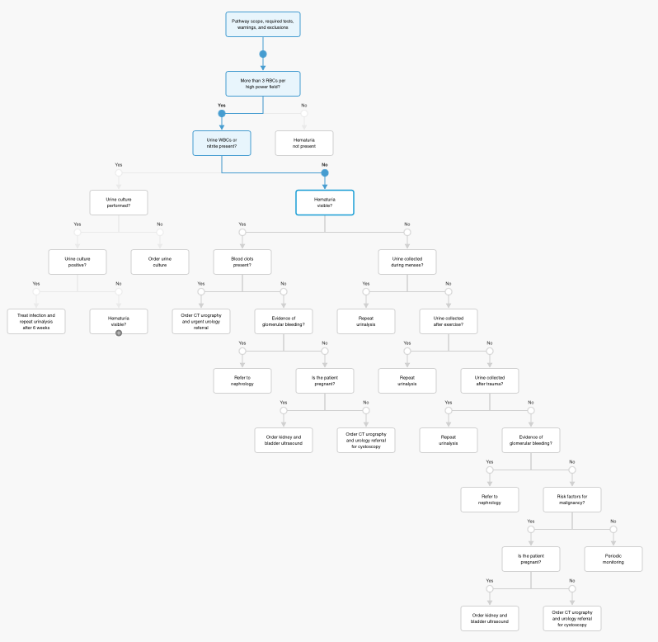
Diagnostic Pathway for Hematuria
(Perazella & O’Leary, 2021)
Notes:
Following the pathway, we go all the way down the right side of the pathway. At this time, the patient does have an increased Creatinine at 1.23. However, the rest of his kidney function looks good. So at this time, my preceptor and I decided to not classify this as evidence of glomular bleeding. He does have risk factors for malignancy including the family history of breast cancer and prostate cancer, he is not pregnant, so that is why the decision was made to order a CT of the abdomen and pelvis and a referral was placed to urology.

Slide 13
Elevated liver enzymes
Found in 8% of general population
Mild = AST and/or ALT elevation is 2-5 times the upper limit of normal.
This patient has ALT-predominant elevation at 137.
  This is indicative of acute or chronic viral hepatitis, steatohepatitis, acute Budd-Chiari syndrome, ischemic hepatitis, autoimmune, hemochromatosis, alpha 1-antitrypsin deficiency, Wilson disease, Celiac disease.
(O’Hara et al., 2023)
Notes:
Our leading diagnosis at this time is steatohepatitis, however, this cannot be confirmed until we have the results of the abdominal ultrasound. We decided on steatohepatitis since the labs we drew eliminated viral cause, autoimmune potential, or alpha 1-antitrypsin deficiency. He also has no signs or symptoms of celiac disease, eliminating this as a potential cause.

Slide 14
Management Course to Date
CT abdomen and pelvis scheduled for 1/15/24
US abdomen scheduled for 1/15/24
Appointment with urology scheduled for 1/24/24
Still waiting for urine cytology results
Notes:
Unfortunately, I do not have more information for this case. We are waiting for him to complete the imaging and meet with urology. At this time, we are still waiting for the urine cytology results. Due to still waiting for results, I do not have a final diagnosis for this case. We did send a message to the patient to explain what we do know.

Slide 15
Summary
37 year-old Hispanic male
Intermittent blood in the urine about 2-3 times per year that he notices it
UA that day did show RBCs in the urine. Still waiting for urine cytology.
Coincidentally through screening, found the patient’s AST and ALT were elevated.
Still waiting for CT of abdomen and US of abdomen.
Referred to urology for hematuria workup.

Slide 16

Has anyone had a similar patient in their clinical rotation? If so, what was done differently?

Slide 17
References
Barber, L., Gerke, T., Markt, S. C., Peisch, S. F., Wilson, K. M., Ahearn, T., Giovannucci, E., Parmigiani, G., & Mucci, L. A. (2018). Family history of breast or prostate cancer and prostate cancer risk. Clinical Cancer Research, 24(23), 5910–5917. https://doi.org/10.1158/1078-0432.ccr-18-0370
Friedman, L. S. (2022). Approach to the patient with abnormal liver biochemical and function tests (S. Chopra & S. Grover, Eds.). UpToDate. Retrieved December 11, 2023, from https://www.uptodate.com/contents/approach-to-the-patient-with-abnormal-liver-biochemical-and-function-tests?search=elevated%20liver%20enzymes%20workup%26source=search_result&selectedTitle=1~150&usage_type=default&display_rank=1#H19408002
O'Hara, G., Mokaya, J., Hau, J. P., Downs, L. O., McNaughton, A. L., Karabarinde, A., Asiki, G., Seeley, J., Matthews, P. C., & Newton, R. (2023). Liver function tests. BMJ open, 10(3). https://doi.org/10.1136/bmjopen-2019-032890
Perazella, M. A., & O'Leary, M. P. (2021). Etiology and evaluation of hematuria in adults (R. J. Glassock & A. Q. Lam, Eds.). UpToDate. Retrieved December 11, 2023, from https://www.uptodate.com/contents/7208?source=icg%26topicId=120406&anchor=H00#H3
Saleem, M., & Hamawy, K. (2022). Hematuria. StatPearls. https://www.ncbi.nlm.nih.gov/books/NBK534213/
Viera, A. J. (2023). Overview of preventive care in adults (J. G. Elmore, J. Givens, & S. Swenson, Eds.). UpToDate. Retrieved December 11, 2023, from https://www.uptodate.com/contents/overview-of-preventive-care-in-adults?search=annual%20physical%20exam%26source=search_result&selectedTitle=1~150&usage_type=default&display_rank=1#H186697089

