Slide 1
Clinical Reasoning Presentation
Cassidy Freeman, BSN, RN, DNP-S & TORI WEINAND, BSN, RN, DNP-S
DEPARTMENT OF NURSING, UNIVERSITY OF MARY
NUR 582 Human Responses, Clinical Decision Making, and Diagnostic Testing
PROFESSOR Annie Gerhardt DNP, APRN, FNP-BC
AUGUST 10, 2022
Notes:
Hello everybody, this is Tori Weinand and Cassidy Freeman and this is our clinical reasoning presentation!

Slide 2
objectives
Introduce a case study
Build the differentials
Generate pertinent positives and negatives
Explain and analyze the patient's case using the process of clinical reasoning
Describe the diagnostic process
Discuss how clinical reasoning influences decision-making based on the diagnostic process
Discuss various clinical situations that would alter the approach
Summarize key points
Reflect
Notes:
In our presentation, we will discuss how to build a diagnosis based on a patient's chief complaint. During the discussion, we will review our differential diagnoses, relevant negatives, positives, and diagnostic pearls that contribute to strengthening the diagnosis. Our discussion will also include how different variables in a patient may change the focus of our diagnosis.

Slide 3
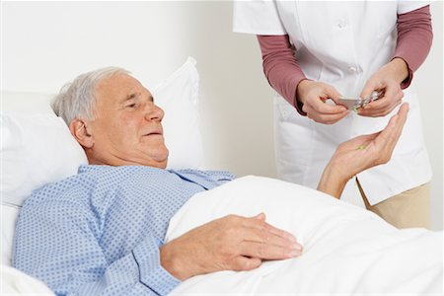
Introduction
John Smith is a 70-year-old, Caucasian male that presents to the ER stating, "My urine is bloody. "
Hematuria is a symptom that must be taken seriously.
REFLECT:
What is your leading diagnosis?
What is your DO NOT MISS diagnosis?
What else do you need to know?
Notes:
READ the slide

Slide 4
Differentials: vindicate
Rhabdomylosis
Endocrine-metabolic:
Ureter – stones, papillomas, & congenital defects
Bladder – cystitis, stones, neoplasms, foreign bodies, & trauma
Prostate – neoplasms & prostatitis
Urethra – stones, neoplasms, & infections
Vascular:
Embolic glomerulonephritis
Renal vein thrombosis
Subacute bacterial endocarditis
Idiopathic thrombocytopenia
Infectious:
Pyelonephritis
Renal TB
Neoplasms:
Hypernephromas
Carcinomas
Papillomas
Degenerative:
Rare
Intoxicants:
Sulfa drugs
Mercury poisoning
Blood transfusion reactions
Congenital:
Polycystic kidneys
Medullary sponge kidneys
Autoimmune:
Acute/Chronic glomerulonephritis
Goodpasture disease
Wegener midline granulomatosis
Lupus erythematosus
Trauma:
Trauma to kidneys
Crush injury to muscles or burns
Hemophilia
(Collins, 2012)
Notes:
We used the VINDICATE mnemonic to identify differential diagnoses for the chief complaint of hematuria. Can you think of any more? There are a lot of questions that need to be answered to narrow this list down. Let's learn more about our patient!

Slide 5

Patient information & HPI
John Smith is a 70-year-old, Caucasian male that presents to the ER with his wife stating, "My urine is bloody".
  He has a history of Type 2 Diabetes and is taking 500 mg of Metformin once a day. His A1C is well controlled at 6.5%.
  J.S. has been smoking about 1 pack of cigarettes per day for the past 40 years.
  Having owned his own painting business for 15 years, J.S. is now retired and spends his days with his wife and grandchildren.
  J.S. remains active by taking classes at the YMCA with friends 3 to 4 times a week.
  Aside from taking 650 mg of acetaminophen occasionally for "general aches and pains," J.S. also takes Loratadine 10 mg daily during the springtime for allergies. He has no other known allergies.
  J.S. denies any surgical history or alcohol/recreational drug use.
(Lotan & Choueiri, 2022)
Notes:
READ the Slide

Slide 6

Patient information Continued...
FH:
Mother – History of high blood pressure (deceased, unknown)
Father – History of type 2 diabetes, high blood pressure, possible cancer (unsure of what kind; deceased at age 50, unknown)
Siblings – The patient has one sister that has a history of type 2 diabetes (alive)
Children – The patient has 2 children. One has a history of high blood pressure; otherwise, they are healthy.
Notes:
READ SLIDE

Slide 7
OLDCARTS
O: The hematuria started late last night, but the patient has experienced increased frequency in the past three months.
L: The patient has blood in his urine.
D: His urine has had a pink tinge or redness each urination since starting last night.
C: The patient does not complain of any pain but does experience frequency and urgency.
A: It has become increasingly red in color since this morning.
R: He tried to drink more water, but that did not seem to help.
T: He has not tried any medications or other treatments.
S: A general discomfort score of 2/10 is reported by the patient, but he is extremely worried about the situation.
(Lotan & Choueiri, 2022)
Notes:
READ the Slide

Slide 8
Review of systems
General: Denies fever, weight gain, and fatigue. Complaints of difficulty sleeping and unintentional weight loss of 10 lbs in the last three months.
HEENT: Denies dizziness, vision changes, vision blurriness, difficulty hearing, and ear pain. Denies decreased sense of smell, sore throat, and trouble swallowing.
Cardiovascular: Denies chest pain, palpitations, and edema.
Respiratory: Denies shortness of breath, cough, or recent illness.
GI: Denies diarrhea, constipation, vomiting, rectal bleeding, or change in bowels. The patient has a bowel movement every day. His last bowel movement was this morning. The patient complains of a little decrease in appetite.
GU: The patient complains of blood in his urine going from pink to bright red starting last night. He has had increased frequency and urgency in the last few months. The patient denies pain.
MS: Denies a history of falls or trauma. Denies muscle pain, bone pain, nerve pain, or restricted movement. Denies swelling or stiffness.
Neuro: Denies weakness, numbness, tingling, or decreased sensation
Psych: The patient is pleasant and denies suicidal ideation, depression, and anxiety. The patient is somewhat nervous.
(Lotan & Choueiri, 2022; Perazella & O'Leary, 2021).
Notes:
Read the slide

Slide 9
Physical Examination
Vitals: Temperature: 98.7F, Pulse: 78, BP: 116/80, RR: 17, O2: 98% on RA. BMI: 23
General: The patient is in no acute distress. Interacts appropriately during the exam. The patient is calm and orientated.
Integumentary: Skin is warm, pink, dry, and intact. No lesions, unexpected growths, or wounds were noted.
HEENT: Head: Normocephalic, atraumatic, no visible or palpable masses, no unexpected nods or tics. Eyes: PERRLA, conjunctiva clear, EOM intact. Ears: EACs clear, hearing intact. Nose: No external lesions, mucosa non-inflamed, expected septum and turbinates. Mouth: Mucous membranes moist, no mucosal lesions. No obvious caries or gingival inflammation. No tonsillar hypertrophy or exudate. No redness was noted to the throat. Neck: Supple, without lesions or adenopathy, thyroid non-enlarged, no thyroid tenderness or nodules. Trachea midline.
Cardiovascular: Regular rate and rhythm. S1, S2 present. No murmur or rubs noted to auscultation. No bruits noted. Pulses 2+ bilaterally tibial and radial. No edema.
Respiratory: Bilateral breath sounds clear and equal. No adventitious lung sounds upon auscultation. No shortness of breath.
GI: Abdomen is non-distended, rounded. Active Bowel Sounds X 4. No friction rubs. No tenderness, masses, or enlargements were noted. No hepatomegaly or hepatic metastases.
GU: Bladder is non-tender. Induration of the prostate on digital rectal examination. No solid pelvic mass, induration, or fixation in the bladder wall on palpation, inguinal adenopathy, enlarged para-aortic lymph nodes, or CVA tenderness.
Musculoskeletal: Ambulating as expected. No signs of pain or stiffness.
Neurologic: Cranial nerves 2-12 intact. No unexpected or extraneous movements.
Psychiatric: Pleasant mood and affect. Expected judgment.
(Kaseb & Aeddula, 2022; Ingelfinger, 2021; Perazella & O'Leary, 2021).
Notes:
Read the slide

Slide 10
Pertinent POsitives & Negatives
Positives
70-year-old
Caucasian
Male
New onset of hematuria ("My urine is bloody")
40 pack year cigarette smoker
Type 2 Diabetes
Former painter
Father had possible cancer history – deceased
Increase urine frequency and urgency over 3 months
Patient has some decrease in appetite
Unintentional weight loss of 10lbs in the last three months
Induration of the bladder on digital rectal examination
Some general discomfort 2/10
Negatives
Denies dysuria
Denies alcohol/recreational drug use
No past surgical history
Denies fever, fatigue, dizziness, chest pain/palpitations, edema, shortness of breath, cough, rectal bleeding, changes in bowels, muscle pain, and weakness
General aches and pains are solved with acetaminophen
No acute distress, chest pain, adventitious lung sounds, history of falls or trauma
Non-tender bladder
No solid pelvic mass, or induration
No fixation in the bladder wall on palpation, inguinal adenopathy , or enlarged para-aortic lymph nodes
No CVA tenderness.
No abdominal tenderness, masses, or enlargements. No hepatomegaly or hepatic metastases.
Notes:
Read the slide

Slide 11

What Diagnosis are you Considering? Why?
UTI?
Bladder Carcinoma?
Nephrolithiasis?
Papillary urothelial hyperplasia?
Interstitial cystitis/nephritis?
Notes:
Read the slide

Slide 12
Diagnostic tests
Recommended
Urinalysis
Abdominopelvic CT
Urology Referral
Cystoscopy with biopsy – GOLD STANDARD
Urine Cytology
Not recommended
Urine-based markers
Intravenous pyelogram (IVP)
Ultrasound
(Gharibvand et al., 2017; Delanghe et al., 2023; Lotan & Choueiri, 2022; Perazella & O'Leary, 2021; Saleem & Hamawy, 2022; Zhu et al., 2017)
Notes:
Now we need to further evaluate this patient through the use of diagnostic tests.
A urinalysis should be done first and should include a microscopic and gross examination as well as a dipstick chemical test. Hematuria is not considered significant unless there are more than 3 RBCs per high-power field. Looking at the RBC morphology may also suggest the cause of the hematuria. For example, normally shaped RBCs are more likely to come from an extrinsic source.
The patient does not have flank pain or signs of a urinary tract infection shown on the urine culture; however, the hematuria is visible and after seeing the urine sample so are clots. By following the algorithm for hematuria the next step identified is to order an abdominopelvic CT with and without contrast for urography. The patient should also be urgently referred to urology. It should be noted that renal function tests for example, GFR, BUN, creatinine, albumin, and electrolytes may help to assess the patient for any risks prior to imaging.
Lets think about the patient's symptoms and test results again: increased urgency, frequency, and hematuria with clots. Unplanned weight loss. No sign of pain or infection per results from the urine test. This leads us to be thinking about malignancy, which is also leading us to the CT and urology consult. Even if it is not malignancy that must be ruled out since it is a do not miss diagnosis.
CT scans with and without contrast are the preferred study for all patients with bladder cancer, regardless of stage. CT scans are replacing intravenous pyelogram as the procedure of choice. It should be noted that CT scans may miss tumors that are less than 1 cm in size. CT is approximately 80% accurate in differentiating locally advanced tumors involving extravesical adipose tissue from less invasive tumors. The sensitivity of CT for identification of nodal involvement is relatively low with a false-negative rate of 68% and a false-positive rate of 16%.
Therefore, a cystoscopy with biopsy is still necessary. This is the gold standard for initial diagnosis and staging of bladder cancer. It has minimal risks and the urologist is able to take a biopsy of any visible tumor or suspicious lesion to send for testing. Transurethral resections of the bladder tumor (TURBT) may also be used to determine the histologic grade and depth of the invasion at that time.
Urine cytology may be used along with cystoscopy to detect Carcinoma in situ and upper-tract malignancies. However, it should be noted that the sensitivity is relatively poor especially for low-grade tumors. The overall sensitivity is 34%. However, the false-positive results are rare with urine cytology with a specificity of greater than 98%. Thus, any positive cytology should be assumed to represent malignancy.
Although there are a multitude of diagnostic tests available for the assessment of hematuria and bladder carcinoma they may not all be recommended.
Urine-based tumor markers have been developed that are based on differential expressions of tumor-related proteins. The pooled sensitivity of urine-based tumor markers ranges from 50 to 80 percent, and specificity ranges from 70 to 90 percent, depending on the analysis. Most urine-based molecular markers are more sensitive than urine cytology in the detection of urothelial cancer, but the specificity of molecular markers is inferior to that of urine cytology. Routine use is not recommended by the American Urological Association because these markers do not have sufficient sensitivity to replace cystoscopy in the assessment of an individual suspected to have bladder cancer and they are not time or cost effective.
Next, intravenous pyelogram is used to visualize both the bladder and upper urinary tracts. IVP should not be used in individuals with renal insufficiency, diabetes mellitus, or other conditions due to the risk of acute renal injury which is why we chose to not order this test for our patient. Additionally, the cystogram phase of the IVP detects 60 to 85 percent of large bladder tumors, but smaller tumors are missed more frequently. The cystoscopy is a much better use of time.
Finally, ultrasound may have a high specificity and sensitivity for bladder cancer with a positive predictive value of 100 and negative predictive value of 16.66. However it has shown to be not useful for the diagnosis or staging of bladder cancer; unless there is good reason the patient cannot utilize the gold standard diagnostic test of cystoscopy (as that has the highest sensitivity and specificity of 97.2% and 97%).
Furthermore, ultrasound can confirm the presence of a soft tissue mass, but cannot determine the depth of invasion, extravesical extension, or nodal status. It can be used in evaluating the upper tracts for renal parenchymal disease, hydronephrosis, and to differentiate a non-radiopaque stone from a soft tissue mass.

Slide 13
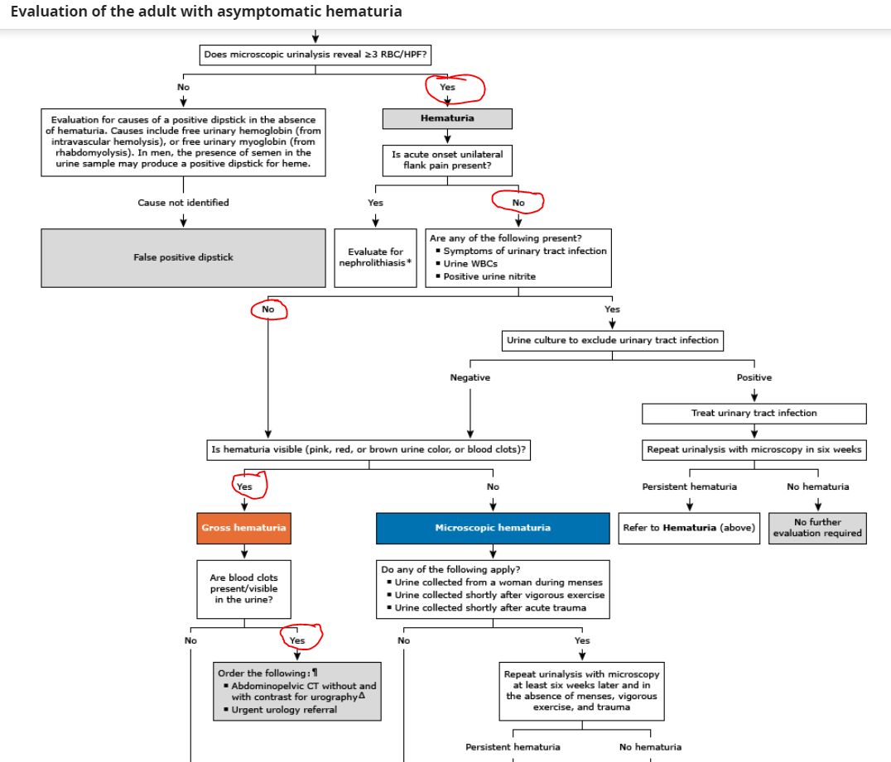
Clinical Pathway for Hematuria
(Perazella & O'Leary, 2021)
Notes:
This is the clinical pathway for hematuria from UpToDate. As you can see the patient had a urine dipstick test due to hematuria the came back after microscopic urinalysis to show greater than or equal to 3 RBC. The patient did not present with flank pain therefore it goes into questioning whether there are signs of infection noted. Since these were not noted on the urinalysis it moves into asking if the patient has visible hematuria which was seen with the presence of clots during obtaining the patients urine sample. Therefore, the patient should have the CT and urology referral. This also leads to the necessity of a cystoscopy with biopsy for bladder carcinoma.

Slide 14
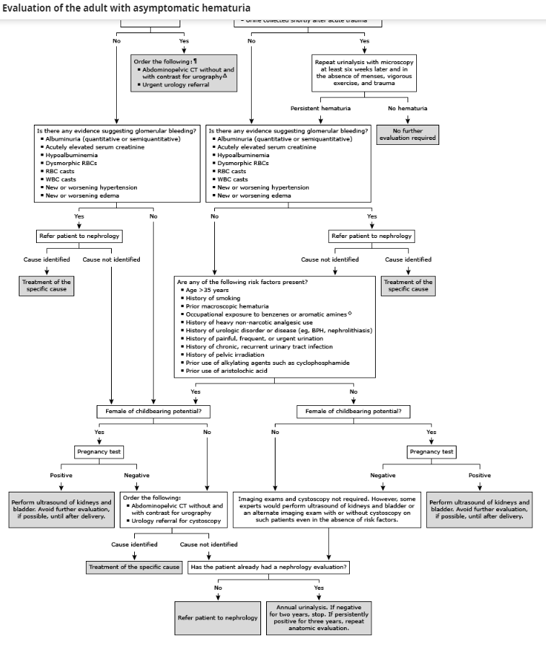
Clinical Pathway for Hematuria Continued...
(Perazella & O'Leary, 2021)
Notes:
This is the rest of the pathway. As you can tell there are a multitude of avenues that this could have went down due to further diagnostic testing and presenting case. This is why all of the information is so critical to pay attention to. It truly builds a case for your patient and points you in the correct direction when there are dozens of differentials to consider.

Slide 15

Clinical reasoning for diagnostic tests
Urinalysis
Abdominopelvic CT
Urology Referral
Cystoscopy with biopsy – GOLD STANDARD
Urine Cytology
(Lotan & Choueiri, 2022; Ingelfinger, 2021; Zhu et al., 2017)
Notes:
Explain the process of clinical reasoning that would push the nurse practitioner toward or away from ordering one or more of diagnostics available for this complaint/diagnosis
The clinical reasoning was discussed via the pathways presented on the previous slides. The recommended diagnostic tests for this patient would include urinalysis, abdominopelvic CT, cystoscopy with biopsy, and cytology. All of which are fairly standard treatment for a patient that is presenting with hematuria. However, there may be some instances when the need arises to switch strategies. For example, if a patient has recently endured a trauma of some sort then hematuria would not be an uncommon finding in a urinalysis and should be repeated at a later time. Additionally, a CT scan may be difficult if the patient has claustrophobia or contrast may be contraindicated in patients with dye allergies or poor kidney function. A cystoscopy would be contraindicated if a patient was presenting with an infection or if they refused considering it is a procedure even if low risk.
However, these diagnostic tests are all important part of the diagnostic process. A cystoscopy with biopsy is the Gold standard diagnostic to diagnose or rule out the 'DO NOT MISS' diagnosis of bladder carcinoma. However, the preceding tests are necessary in order to appropriately choose cystoscopy as the favored and best test for this patients individual situation.

Slide 16
Analyzing various scenarios
What if?
What if he was complaining of hematuria and urinary retention?
What if the patient was a child?
What if the hematuria occurred after a car accident?
Notes:
Variation in the clinical display could occur with different variables relating to the patient and presentation. If the patient presents with hematuria and urinary retention, this may lead the clinician down a different path. This new path would consist of using a bedside ultrasound to assess the amount of urine in the bladder and potentially treating the full bladder by placing a catheter until further workup can be done. If it is found that there is a blockage due to clots in the bladder or urethra, a large French catheter can be placed and irrigation with 0.9% normal saline should be done to prevent further clotting (American Urological Association, 2022).
The majority of children who present with gross hematuria have an easily recognizable and apparent cause. Typically diagnosis is done by complete history, physical exam, and a urinalysis. Cystoscopy is rarely indicated for hematuria in children (Boyer, 2023).
For individuals who are having hematuria after a car accident, it is important to rule out renal trauma. This is done by completing a CT scan with contrast. The treatment would then consist of conservative measures if the patient is hemodynamically stable which can include monitoring the hemoglobin and hematocrit, bedrest, and possibly blood transfusions. If they are hemodynamically unstable, there are 2 types of intervention that can be done. This includes angioembolization and surgical management (American Urological Association, 2022).

Slide 17
Jenicek Tools of Augmentation
The patient is experiencing new onset hematuria, general discomfort of 2/10, and increased frequency and urgency when voiding.
This patient is displaying several symptoms consistent with Bladder carcinoma. Therefore, this patient should be further evaluated.
Bladder carcinoma presents with hematuria, occasionally pain, and voiding symptoms such as dysuria, increased frequency, and urgency
Major Premise
Minor Premise
Conclusion
(Jenicek, 2013)
Notes:
This slide discusses how we utilized the three-element reasoning or categorical syllogism. To reason this way, we need to initiate a major premise, a specific or minor premise, and a conclusion that results from linking between the major and minor premise (Jenicek, 2013). Our general or major premise is that bladder carcinoma presents with hematuria, pain, and voiding symptoms such as dysuria, increased frequency, and urgency. The minor premise is then our patient is experiencing new onset hematuria, general discomfort, and increased frequency and urgency. The Conclusion is that the patient is displaying several symptoms consistent with bladder carcinoma so further evaluation is necessary.

Slide 18
Illustrative fallacies
Anchoring Fallacy: Overly relate to early observed features of disease presentation in the diagnostic process and jump prematurely to conclusions.
Diagnostic Oversimplification Fallacy: Occurs in reasoning and arguments that are based on exclusive and exhaustive “yes or no” considerations when other alternatives and options exist.
Ascertainment Fallacy: Thinking is pre-shaped by expectations of what we specifically hope to find.
(Jenicek, 2013)
Notes:
In our case study, it would be easy to jump to conclusions and potentially miss a diagnosis as can be done with the anchoring fallacy. For example, “looking at our patients presenting symptoms of hematuria and unintended weight loss this must mean he has bladder carcinoma.”
An example in our case study of diagnostic oversimplification fallacy would be “does the patient have hematuria, dysuria, polyuria, and unintended weight loss? The patient has bladder carcinoma.” This unilateral way of reasoning is an oversimplification of the diagnostic process and does not allow the clinician to fully rule out other potential diagnosis.
Thinking about ascertainment fallacy or not detaching ourselves enough from our preconceived notions of what we specifically hope to find....Perhaps our patient has been in for repeated UTI's and keeps coming back. Instead of addressing, the root cause we continue to prescribe an antibiotic and educate the patient on proper hygiene. This is an example of a 'Do NOT miss' diagnosis. In this case we are not even allowing ourselves to think outside of the box (Jenicek, 2013).

Slide 19
Conclusion
Using information from basic patient information differential diagnoses were compiled.
The HPI, history, ROS, physical assessment, and pertinent information helped to narrow differentials and assess severity.
Diagnostics were reviewed and helped to narrow down differentials.
Certain tests were identified as more appropriate than others depending on the patient's situation.
It was reviewed that certain scenarios may alter the diagnostic plan & being aware of fallacies is critical.
Notes:
To conclude, lets go over what we have discussed. We have discussed the importance of a thorough HPI, past medical history, review of symptoms, and physical assessment in order for us to think of the possible diagnosis
It is important to look at the patient in front of us to assess the severity of the symptoms they are presenting with.
Diagnostic tests can assist us in ruling in or ruling out current differential diagnoses.
Certain tests are more appropriate to conduct depending on the patient and their presenting signs and symptoms.
Different scenarios may alter the diagnostic plan
And most importantly, be aware of potential fallacies and do not anchor on a diagnosis.
This is a complex process that is absolutely critical to for future nursing practice and for high quality patient care outcomes.

Slide 20

reflect
What was done well and what could have been handled differently?
Did you make assumptions throughout the case study that may have impacted the outcome?
What did you learn, and how can you incorporate that into your studies or future practice?

Slide 21

References
American Urological Association. (2022). Urologic emergencies. American Urological Association. https://www.auanet.org/meetings-and-education/for-medical-students/medical-students-curriculum/urologic-emergencies
Boyer, O. G. (2023). Evaluation of gross hematuria in children. UpToDate. https://www.uptodate.com/contents/evaluation-of-gross-hematuria-in-children?search=blood%20in%20urine%20children%26source=search_result&selectedTitle=1~150&usage_type=default&display_rank=1#topicContent
Collins, D., R. (2012). Differential diagnosis and treatment in primary care. (6th ed.). Wolters Kluwer Publishing
Delanghe, J., Speeckaert, M., Delanghe, S., & Oyaert, M. (2023). Pitfalls in the diagnosis of hematuria. Clinical Chemistry and Laboratory Medicine, 61(8), 1382–1387. https://doi-org.ezproxy.umary.edu/10.1515/cclm-2023-0260
Ingelfinger, J. (2021). Hematuria in adults. New England Journal of Medicine, 385(2), 153-163. https://doi.org/10.1056/NEJMra1604481
Jenicek, M. (2013). A primer on clinical experience in medicine. Reasoning, decision making, and communication in health science. CRP Press, Taylor & Francis Group
Kaseb, H., & Aeddula, N., (2022). Bladder cancer. National Library of Medicine. StatPearls. https://www.ncbi.nlm.nih.gov/books/NBK536923/
Lotan, Y. & Choueiri, T. (2022). Clinical presentation, diagnosis, and staging of bladder cancer. UpToDate. https://www-uptodate-com.ezproxy.umary.edu/contents/clinical-presentation-diagnosis-and-staging-of-bladder-cancer?search=bladder%20cancer&source=search_result&selectedTitle=1~150&usage_type=default&display_rank=1
Perazella, M. & O'Leary, M. (2021). Etiology and evaluation of hematuria in adults. UpToDate. https://www-uptodate-com.ezproxy.umary.edu/contents/etiology-and-evaluation-of-hematuria-in-adults?search=hematuria&source=search_result&selectedTitle=1~150&usage_type=default&display_rank=1
Saleem, M. & Hamawy, K. (2022). Hematuria. National Library of Medicine. StatPearls. https://www.ncbi.nlm.nih.gov/books/NBK534213/#
Zhu, C. Z., Ting, H. N., Ng, K. H., & Ong, T. A. (2019). A review on the accuracy of bladder cancer detection methods. Journal of Cancer, 10(17), 4038–4044. https://doi.org/10.7150/jca.28989

